Slide 1
Save upto 50% on ERP, CRM, HRM
Get your business Online with Unlimited Users
Introducing New Enterprise Software for Small, Medium Businesses
Website: www.fileian.com
Email: team@fileian.com
Call: 9175 975 009 / 909 630 22 11

Slide 2
The HR Revolution brewing just for you
What is Frappe HR?
Frappe HR is a modern, user-friendly solution to drive excellence within your team. Simplify your HR and Payroll operations with a product crafted as per your needs.
Easy to use, easier to manage
We believe in the freedom of choice
Affordable and Inclusive
Website: www.fileian.com
Email: team@fileian.com
Call: 9175 975 009 / 909 630 22 11

Slide 3
The HR Revolution brewing just for you
15+
5000+
60+
years in business
team, built for success
customers across domains
Website: www.fileian.com
Email: team@fileian.com
Call: 9175 975 009 / 909 630 22 11

Slide 4
The HR Revolution brewing just for you
5000+
customers across domains
Website: www.fileian.com
Email: team@fileian.com
Call: 9175 975 009 / 909 630 22 11

Slide 5
The HR Revolution brewing just for you
5K+
$1B+
12K+
global users
transactions
community
10K+
150+
7K+
hrs of implementation
countries
installations
Website: www.fileian.com
Email: team@fileian.com
Call: 9175 975 009 / 909 630 22 11

Slide 6
About
World’s top 100% open-source ERP
High feature coverage
Serves multiple domains and industries
12,000+ community members
Modern and scalable web platform
Powered by Frappe Framework
Domains
Manufacturing | Retail | Services
HealthCare | Fintech (BFSI) | Distribution
Website: www.fileian.com
Email: team@fileian.com
Call: 9175 975 009 / 909 630 22 11

Slide 7
Features & Modules
Employee Lifecycle
Shift, Time & Attendance
Leave Management
Recruitment
Expense Management
Salary Payouts
Tax & Benefits
Website: www.fileian.com
Email: team@fileian.com
Call: 9175 975 009 / 909 630 22 11

Slide 8
Why Frappe HR
Open Source
Easier to use
and configure
Personalizable and flexible
Powered by Frappe Framework
Single source of truth
Cross-platform compatibility
Helps in planning and managing Eliminates redundancy
Website: www.fileian.com
Email: team@fileian.com
Call: 9175 975 009 / 909 630 22 11

Slide 9
Testimonials
ERPNext has been very integral in our journey
It’s the most agile ERP on the planet
Kailash Nadh
CTO, Zerodha
Simone Micheli
Project Manager, Wallbox
We’re confident that ERPNext will be the future
The magic that has been built and continue to be built is futuristic..
Deepafi Ingle
Reliance Industries
Salim
Business Consultant
Website: www.fileian.com
Email: team@fileian.com
Call: 9175 975 009 / 909 630 22 11

Slide 10
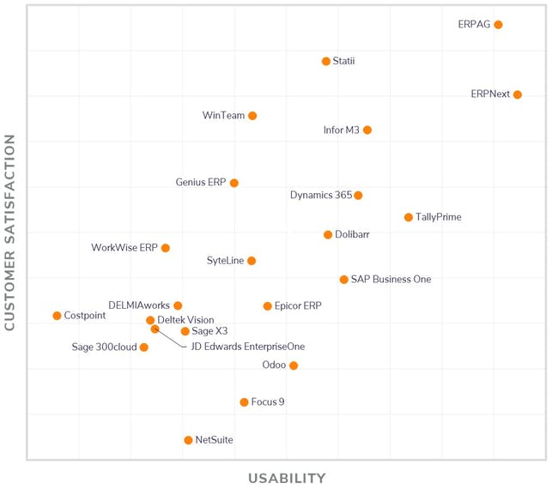
The HR Revolution brewing just for you
Modules & Screenshots
ERPNext Standards here in the Competition
Website: www.fileian.com
Email: team@fileian.com
Call: 9175 975 009 / 909 630 22 11

Slide 11
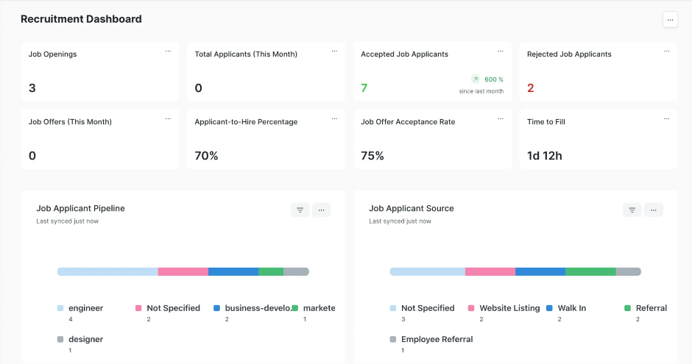
Dashboard
Website: www.fileian.com
Email: team@fileian.com
Call: 9175 975 009 / 909 630 22 11

Slide 12
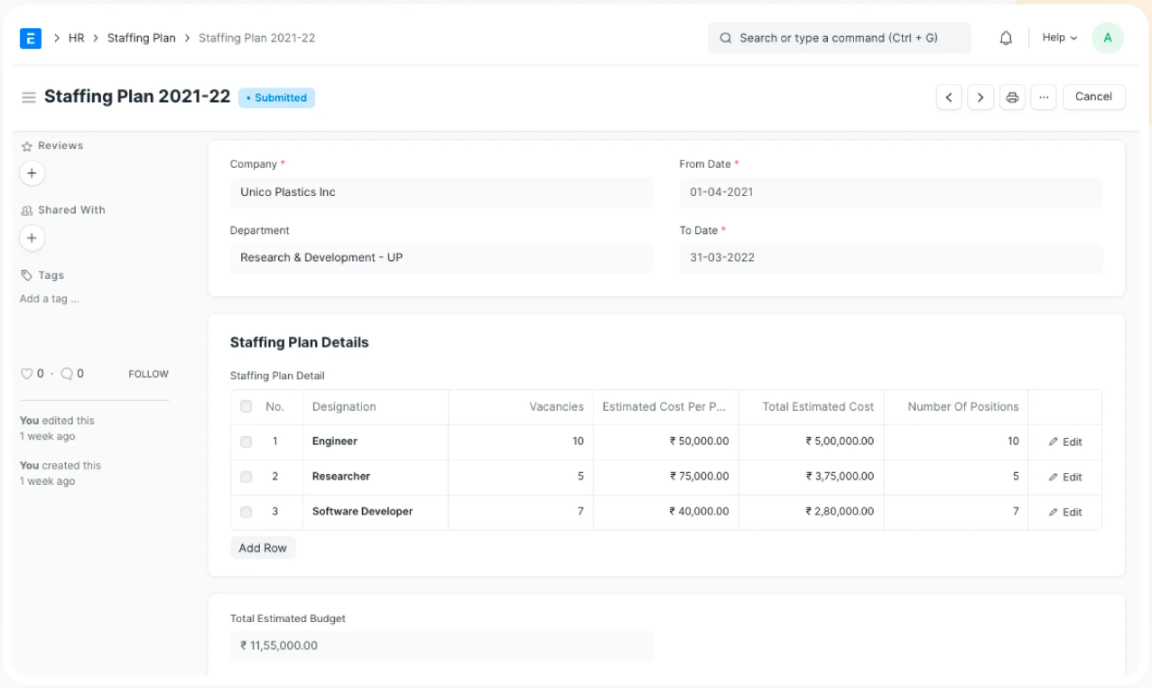
Staffing Plan
Website: www.fileian.com
Email: team@fileian.com
Call: 9175 975 009 / 909 630 22 11

Slide 13
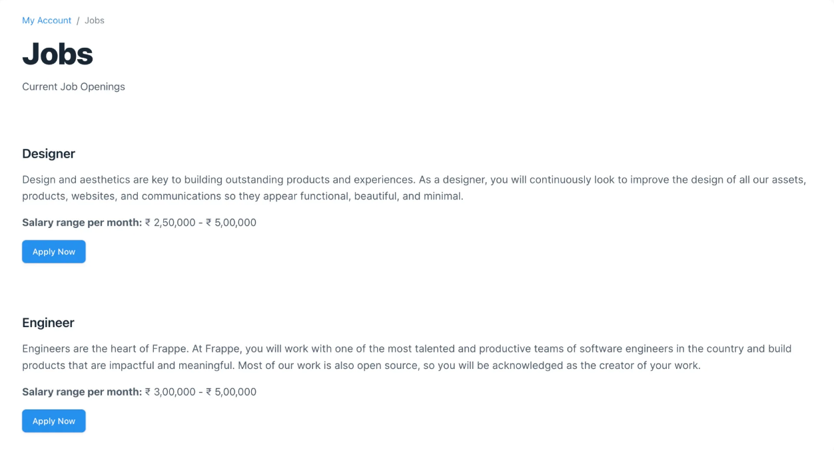
Job Opening
Website: www.fileian.com
Email: team@fileian.com
Call: 9175 975 009 / 909 630 22 11

Slide 14
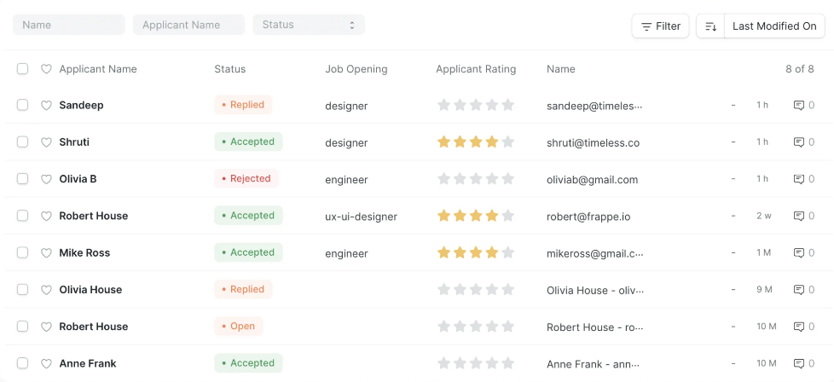
Job Applicant
Website: www.fileian.com
Email: team@fileian.com
Call: 9175 975 009 / 909 630 22 11

Slide 15
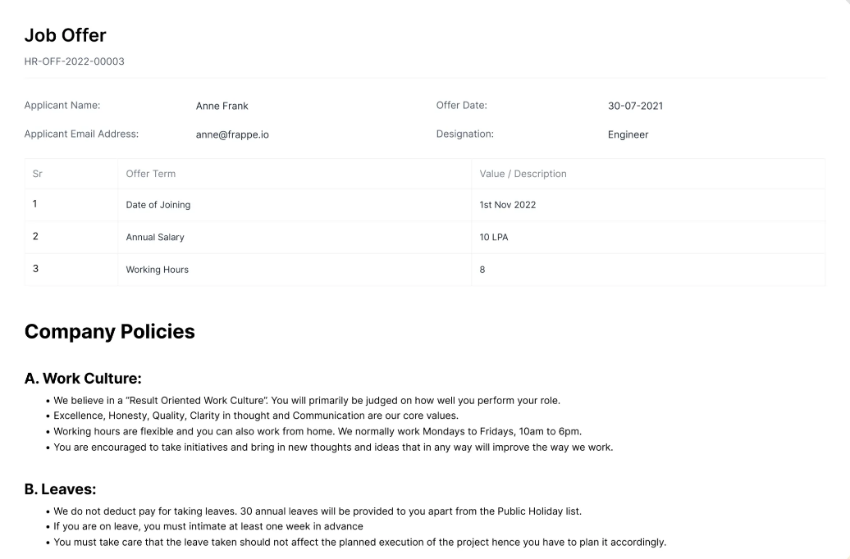
Job Offer
Website: www.fileian.com
Email: team@fileian.com
Call: 9175 975 009 / 909 630 22 11

Slide 16
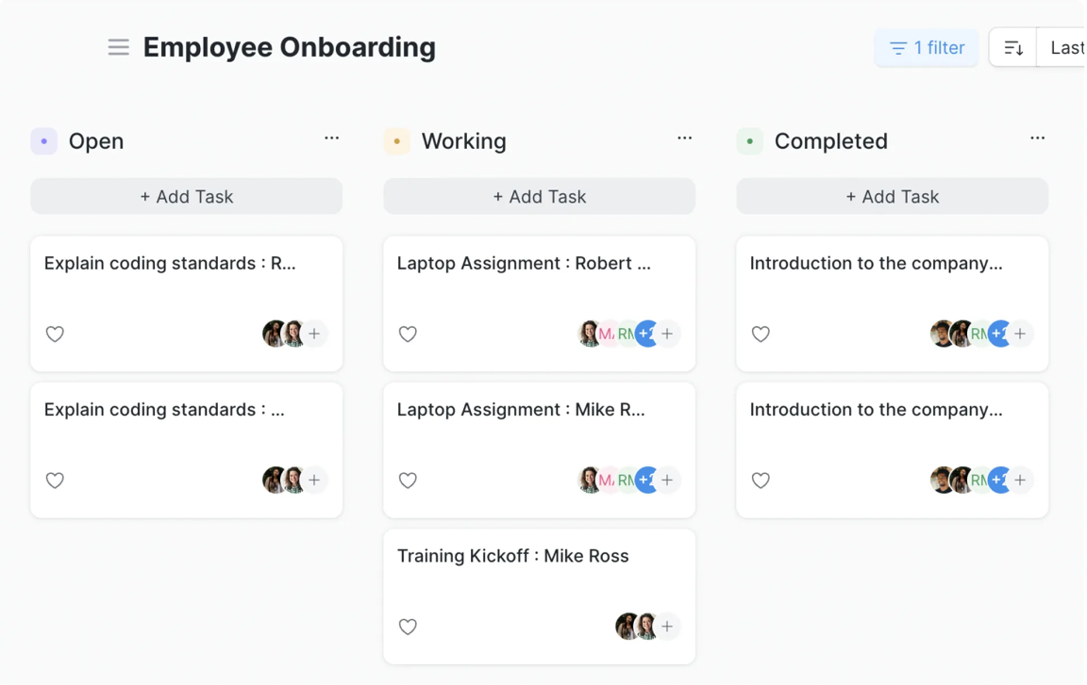
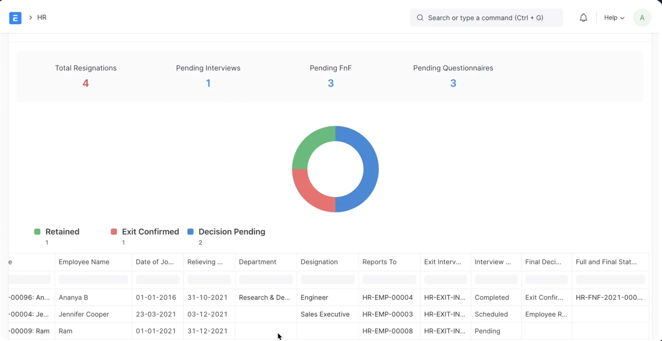
Employee Onboarding & Exit
Website: www.fileian.com
Email: team@fileian.com
Call: 9175 975 009 / 909 630 22 11

Slide 17
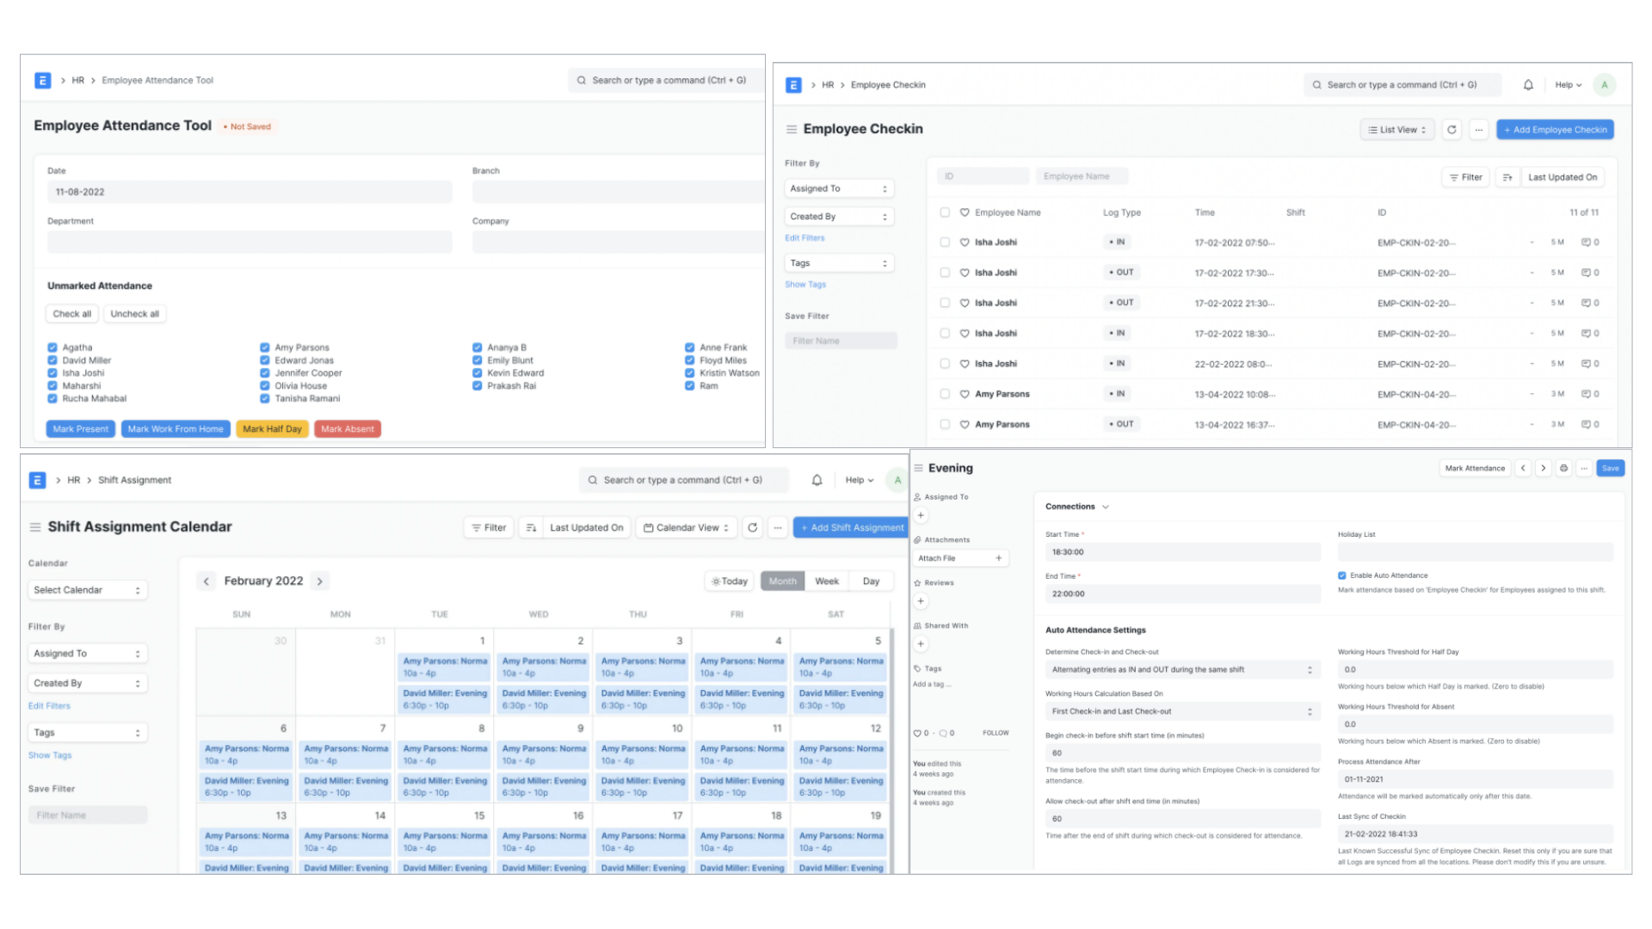
Shifts, Time & Attendance
Website: www.fileian.com
Email: team@fileian.com
Call: 9175 975 009 / 909 630 22 11

Slide 18
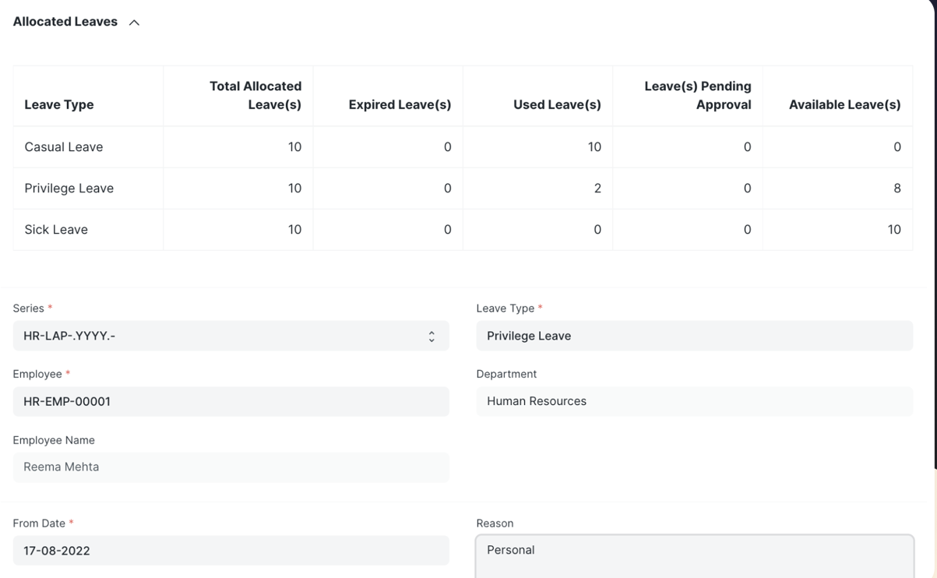
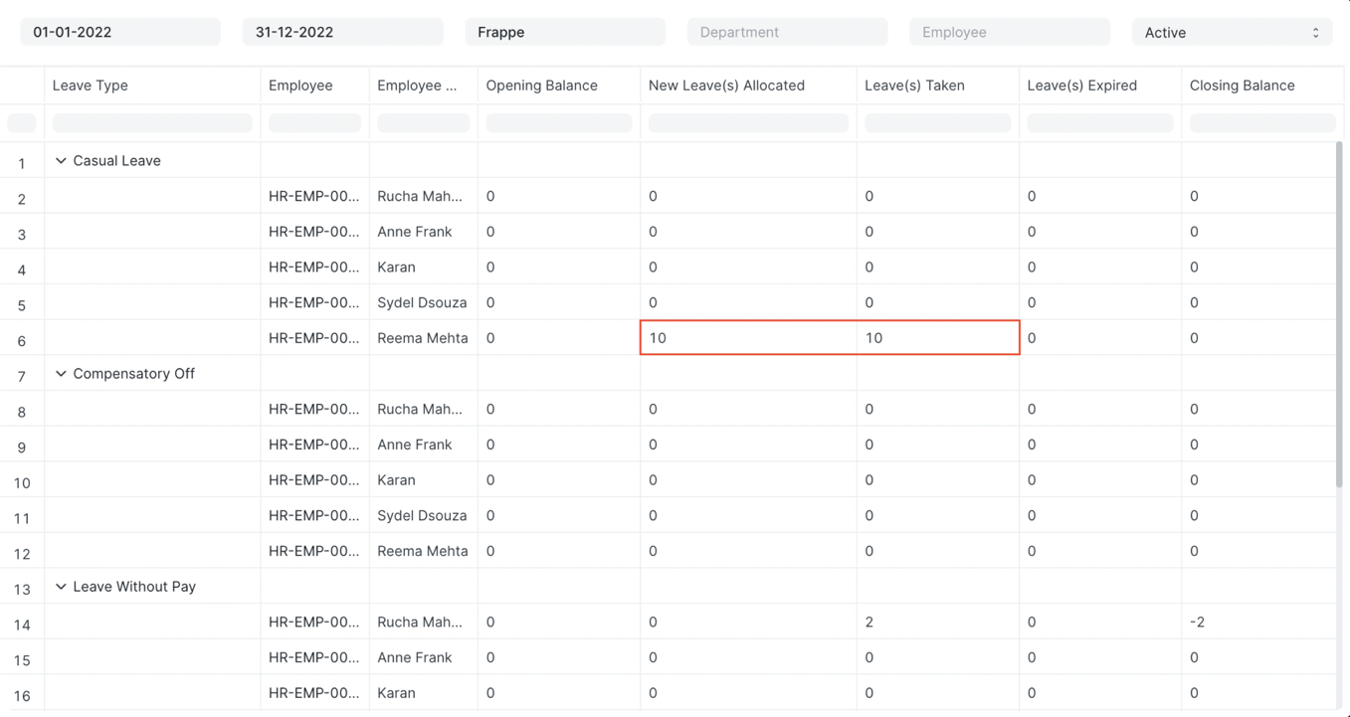
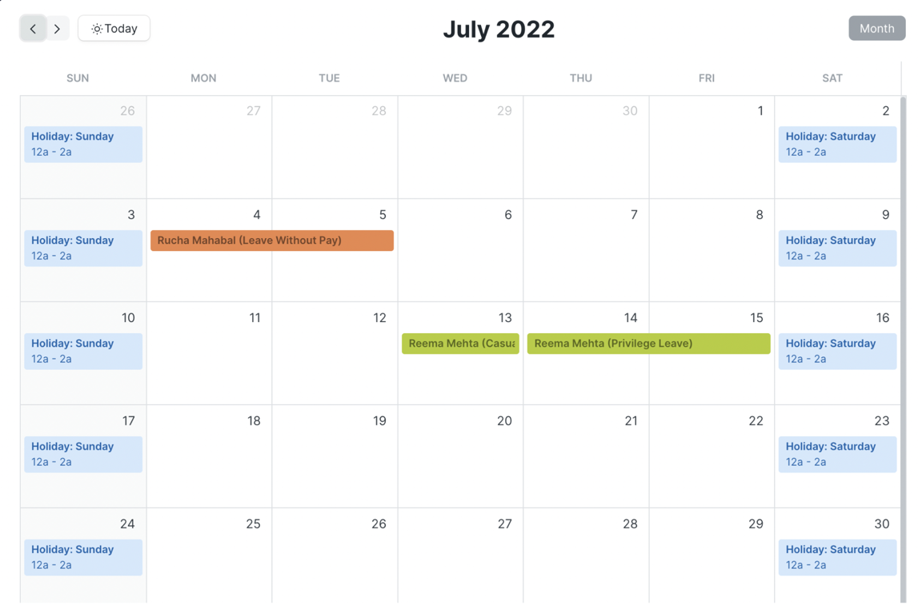
Leave Management
Website: www.fileian.com
Email: team@fileian.com
Call: 9175 975 009 / 909 630 22 11

Slide 19
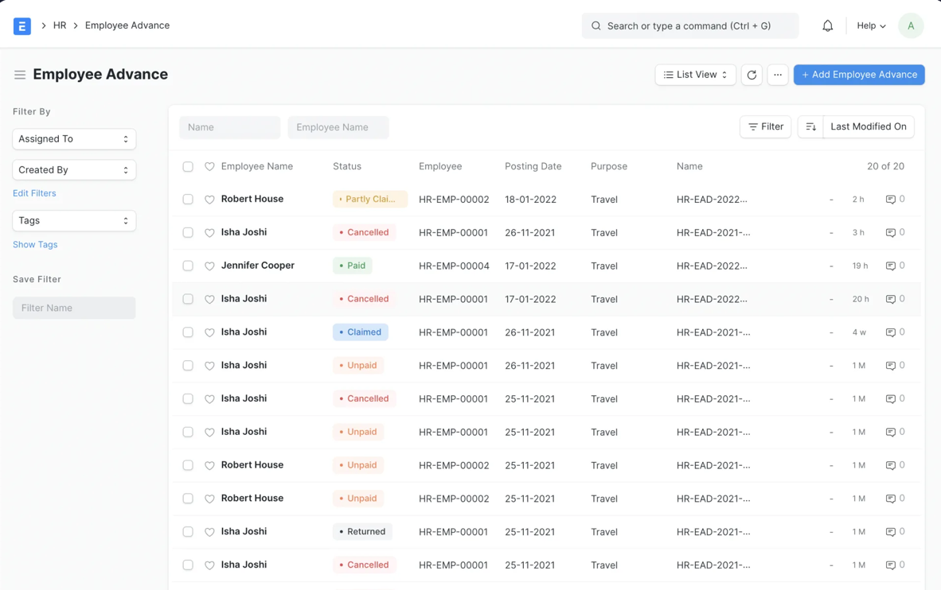
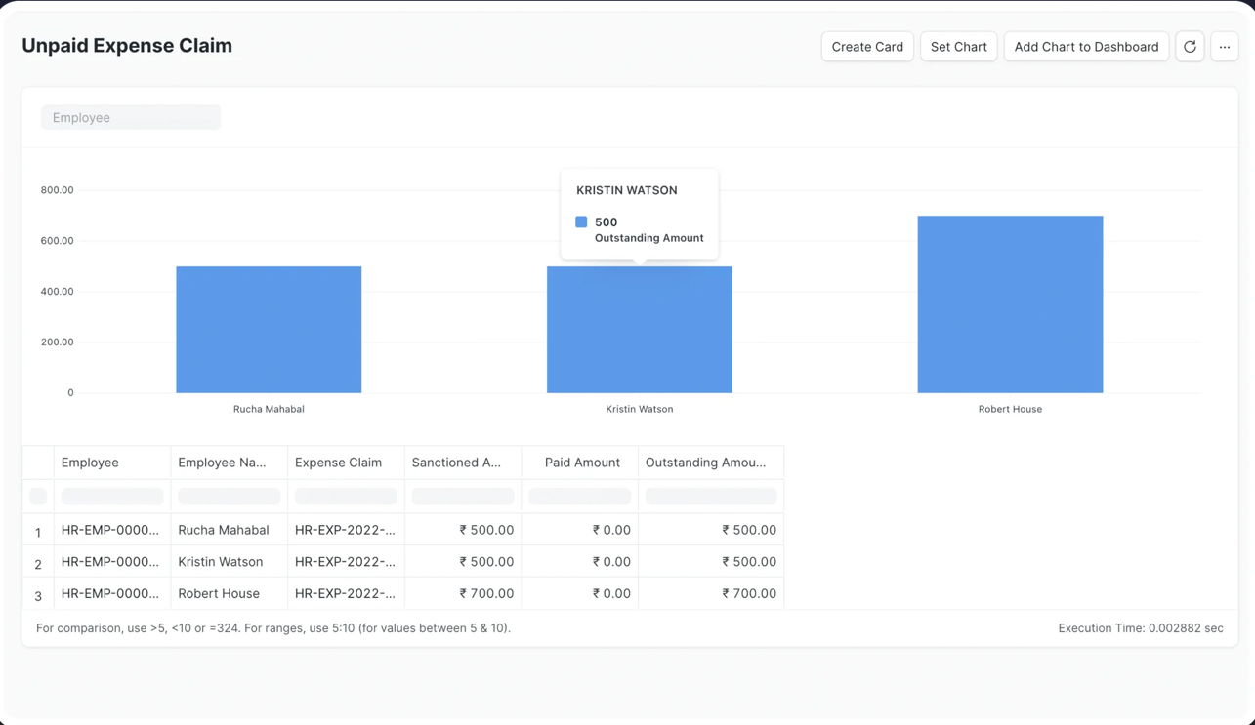
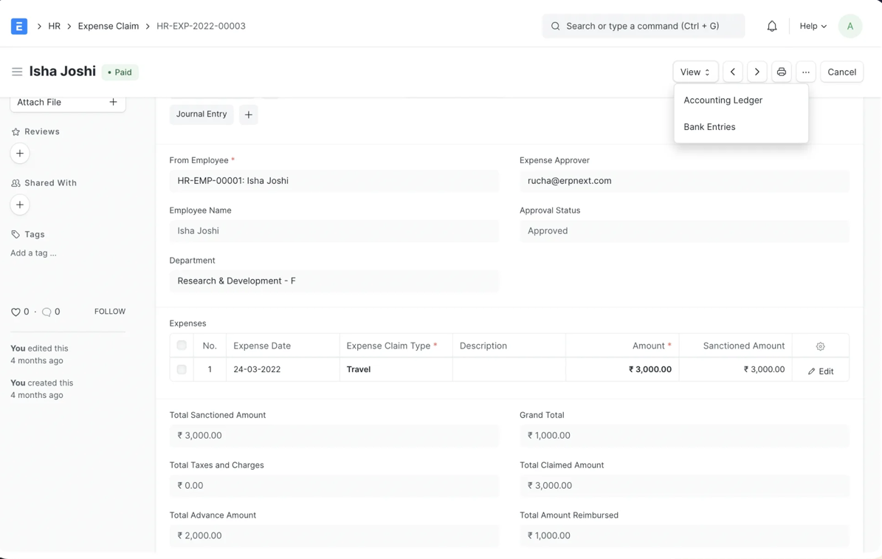
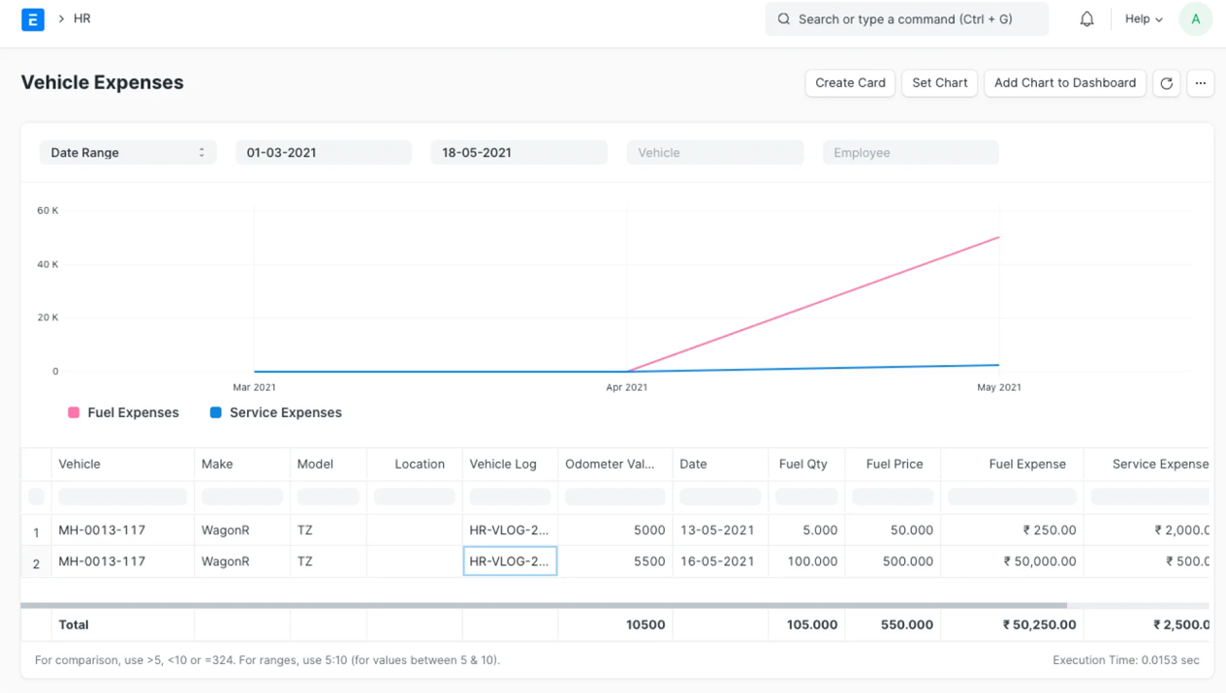
Expense Management
Website: www.fileian.com
Email: team@fileian.com
Call: 9175 975 009 / 909 630 22 11

Slide 20
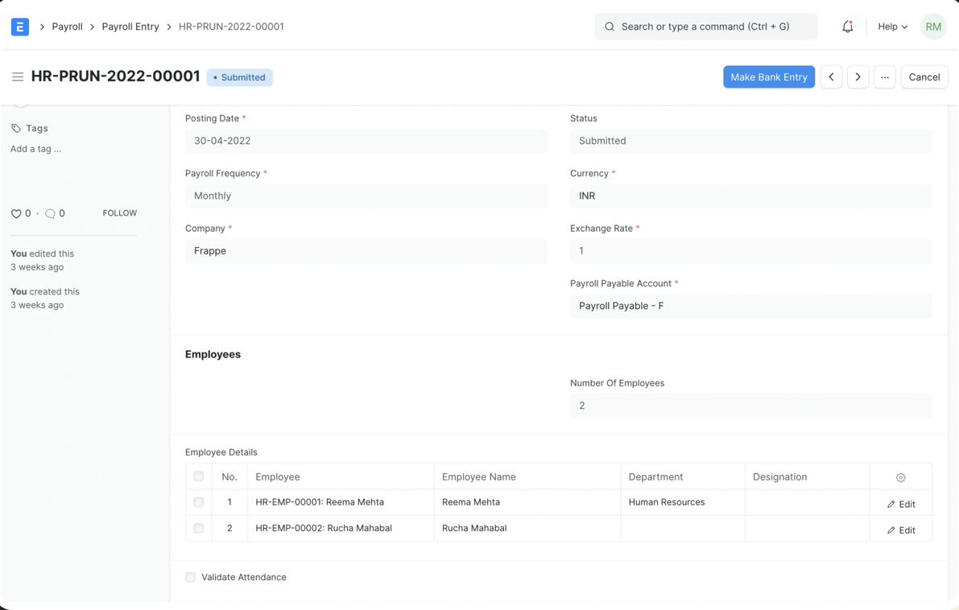
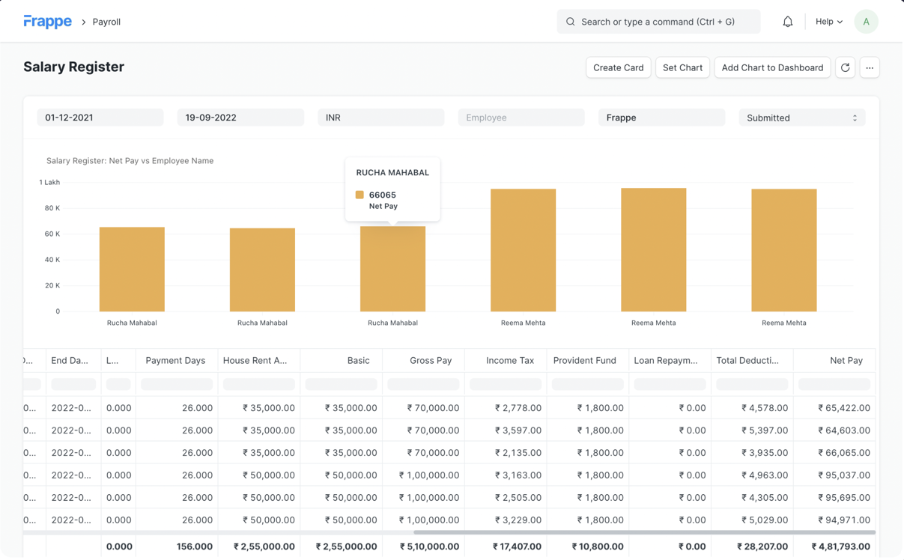
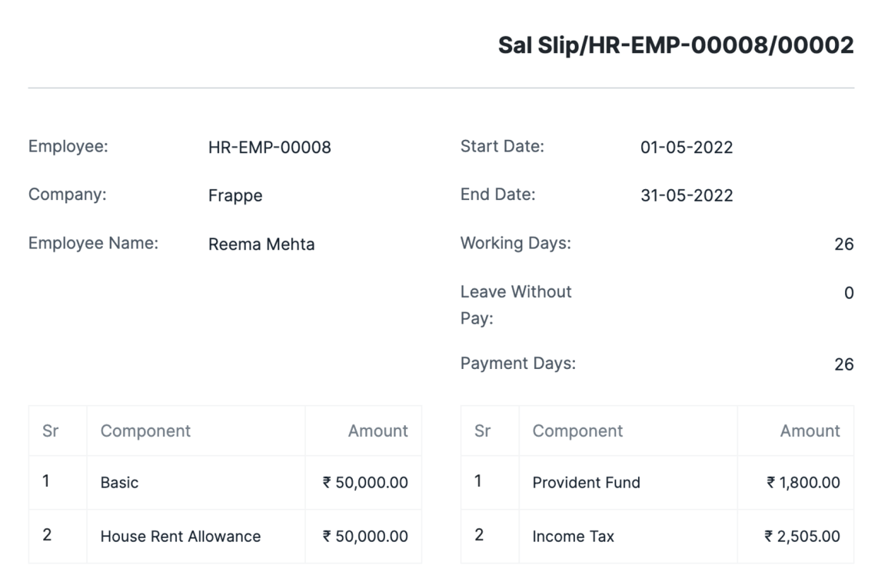
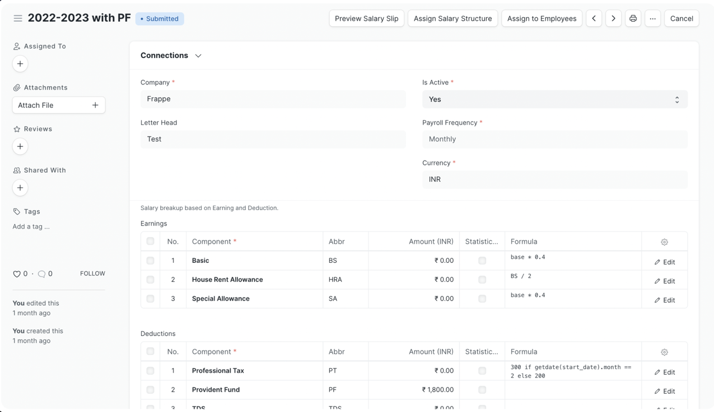
Salary Payouts
Website: www.fileian.com
Email: team@fileian.com
Call: 9175 975 009 / 909 630 22 11

Slide 21
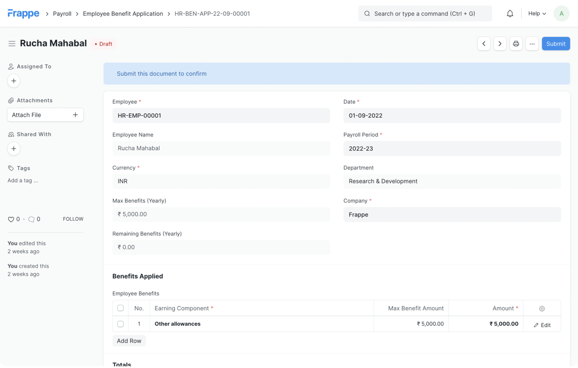
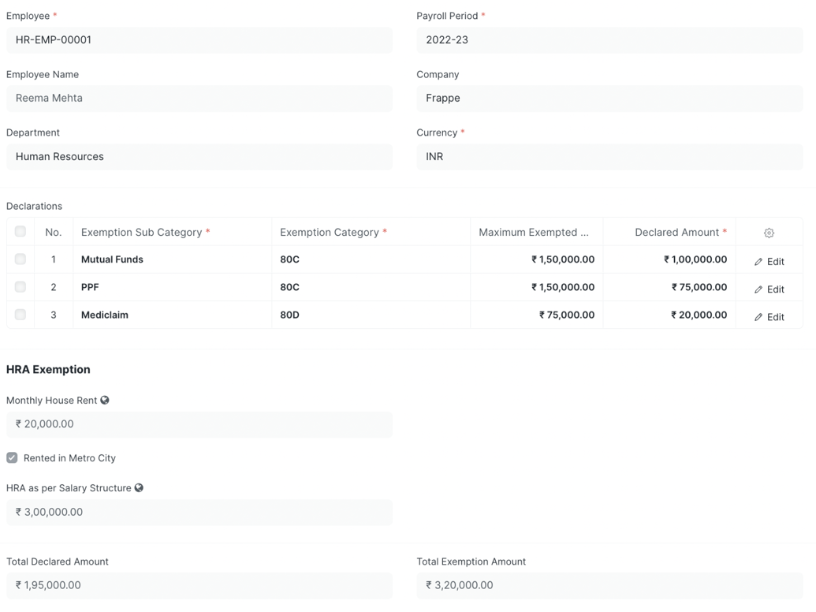
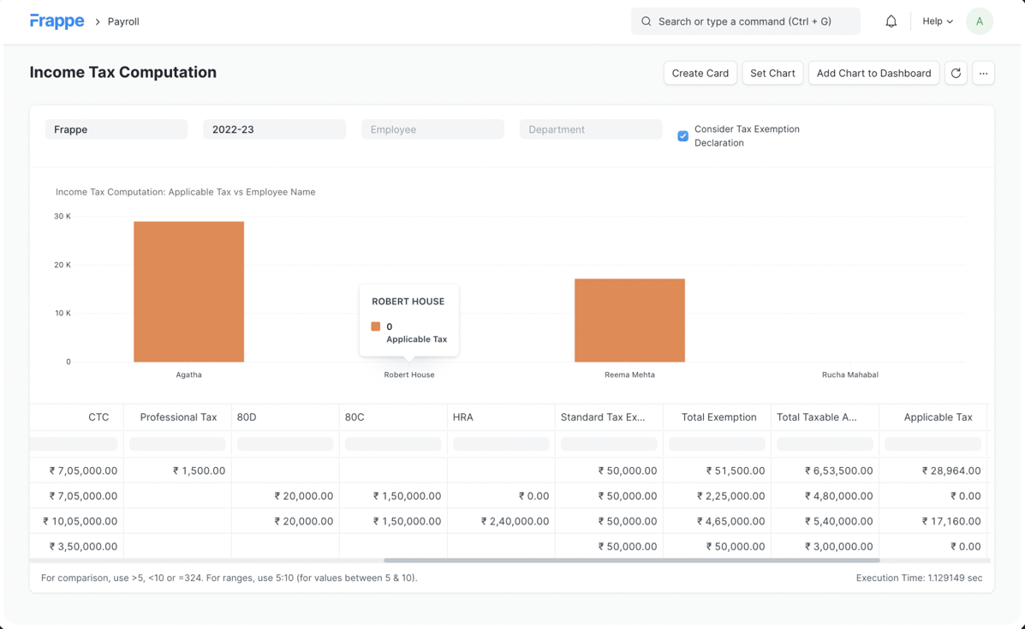
Tax & Benefits
Website: www.fileian.com
Email: team@fileian.com
Call: 9175 975 009 / 909 630 22 11

Slide 22
Module Support
Job Opening
Employee Onboarding & Exits
Staffing Plan
Promotions & Transfers
Tax Declarations
Payroll Entry
Grievance
Salary Structure
Auto Attendance
Expense Claims.
Website: www.fileian.com
Email: team@fileian.com
Call: 9175 975 009 / 909 630 22 11

Slide 23
Modules
Recruitment Modules
Employee Lifecycle
Staffing Plan
Job Opening
Job Applicant
Interview
Job Offer
Staffing Plan
Onboarding
Exits
Promotions & Transfers
Grievance
Employee Reminders
Shifts, Time & Attendance
Leave Management
Attendance Tools
Check-in
Auto Attendance
Shift Assignment
Attendance Reports
Leave Policy
Leave Calendar
Leave Application
Holiday List
Leave Encashment
Leave Balance Reports
Website: www.fileian.com
Email: team@fileian.com
Call: 9175 975 009 / 909 630 22 11

Slide 24
Modules
Expense Management
Tax & Benefits
Expense Claims
Advances
Fleet Management
Claim Reports
Tax Declarations
Tax Reports
Flexible Benefits
Salary Payouts
Salary Structure
Salary Slips
Payroll Entry
Integrated with Timesheets
Additional Salaries
Payroll Reports
Payroll Analytics
Website: www.fileian.com
Email: team@fileian.com
Call: 9175 975 009 / 909 630 22 11

Slide 25
Benefits of ERPNext
Cost Effective
Simplicity
Unlimited User creation
No in-house infrastructure required
(Cloud based system)
Low cost of acquisition, implementation and customer support
Web-based system
Easy Customization and extension
Mobile Access
Extensive functionalities
Integrated into a single platform
Adaptability & Flexibility
Real-time Analytics
Integrations with attendance machines, Google services
Allow remote access and offline capabilities
Custom Workflows
On-the-fly Customization
Analytics, Reports and Dashboards are updated across department as soon as data updated
Secure, Cloud based with offline capabilities
Website: www.fileian.com
Email: team@fileian.com
Call: 9175 975 009 / 909 630 22 11

Slide 26
Comparison with Competitors
Comparison | Frappe (Fileian) | SAP | Oracle | Microsoft | SaaS Software
Licensing Cost | Free | Paid | Paid | Paid | Paid
Users Limit | Unlimited | Limited | Limited | Limited | Limited
Cloud Hosting Type | Private / Public Cloud | Private / Public Cloud | Private / Public Cloud | Public Cloud | Public Cloud
Cloud Hosting Cost | Starting < 10K | Starting > 50K | Starting > 50K | Starting > 50K | Included
Implementation Time | 6 to 12 Weeks | 12 to 24 Weeks | 12 to 24 Weeks | 6 to 12 Weeks | No Applicable
Implementation Cost | Low | High | High | Medium | High
Customisation Type | Full (Low Code No Code) | Partial | Partial | Limited | Not Applicable
Customisation Time | Low | Very High | Very High | High | Not Applicable
Customisation Cost | Low | Very High | Very High | Medium | Not Applicable
Migration Cost | Low | Very High | High | Medium | High
Integrations Cost | Low | High | High | Medium | Very High
Security | Yes | Yes | Yes | Yes | No
Maintenance Cost | Low | Very High | Very High | High | High
Website: www.fileian.com
Email: team@fileian.com
Call: 9175 975 009 / 909 630 22 11

Slide 27
Comparison with Freelancers & Inhouse Team
Parameter | Fileian | Freelance Developer | In-House Development
Time to get right developers | 1 day - 2 weeks | 4 - 12 weeks | 1 - 12 weeks
Time to start a project | 1 day - 2 weeks | 1 - 12 weeks | 2 - 10 weeks
Acquisition cost | 0 | 0 | $9,000 - $25,000
Recurring cost of training & benefits | 0 | 0 | $5,000 - $10,000
Pricing (weekly Average) | 1.5x | 1x | 4x
Time to scale size of team | 1 day - 2 weeks | 1 - 12 weeks | 4 - 16 weeks
Project failure risk | Extremely Low | Very High | Low
Termination costs | NONE | None | High
Developers backed by a delivery team | YES | No | Some
Agile Development methodology | YES | No | Some
Quality assurance | YES | Some | No
Impact due to turnover | NONE | High | High
Structured training programs | YES | No | Some
Communications | Seamless | Uncertain | Seamless
Tools and professional environment | Best-in-Class | No | Varies
Website: www.fileian.com
Email: team@fileian.com
Call: 9175 975 009 / 909 630 22 11

Slide 28
Project Implementation (Standard Practice)
Understanding Customer Requirement
Master Data Creation
Print Format Customization
Integrations
Step 1
Step 2
Step 3
Step 4
Step 5
Step 6
Step 7
Step 8
Accounts Setup
Implementation of Purchase/Sale/
Inventory Cycle
Manufacturing Implementation
Data Transfer to Go-Live and Final Training
Website: www.fileian.com
Email: team@fileian.com
Call: 9175 975 009 / 909 630 22 11

Slide 29
Building awesome enterprise applications
About Fileian
We Drive Your Data With Trust & Security !
Fileian is CMMI Level 3, ISO & DIPP Certified Company trusted by Enterprises & Governments for hassle free Applications Consulting, Development & Maintenance Projects.
Website: www.fileian.com
Email: team@fileian.com
Call: 9175 975 009 / 909 630 22 11

Slide 30
About Fileian
Fileian Ventures Private Limited
Our mission is to give Clarity, Capability & Courage to Clients to build business using technology efficiently.
Established in 2016 to provide easy access to Enterprises with Affordable and Efficient Technology for Small, Mid & large size businesses. At Fileian, we have expert team to manage and maintaining ERP, CRM, HRM systems. We have successfully completed more than 100 Projects.
# Recently Implemented Customised Enterprise Application at Heathrow Airport, London
Company Registrations:
CIN Number: U74999MH2016PTC280265 ISO 9001:2015 Number: IN13506A
GST Number: 27AAFCD6767M1ZZ CMMI Level 3 Number: SPC19C3491

Slide 31
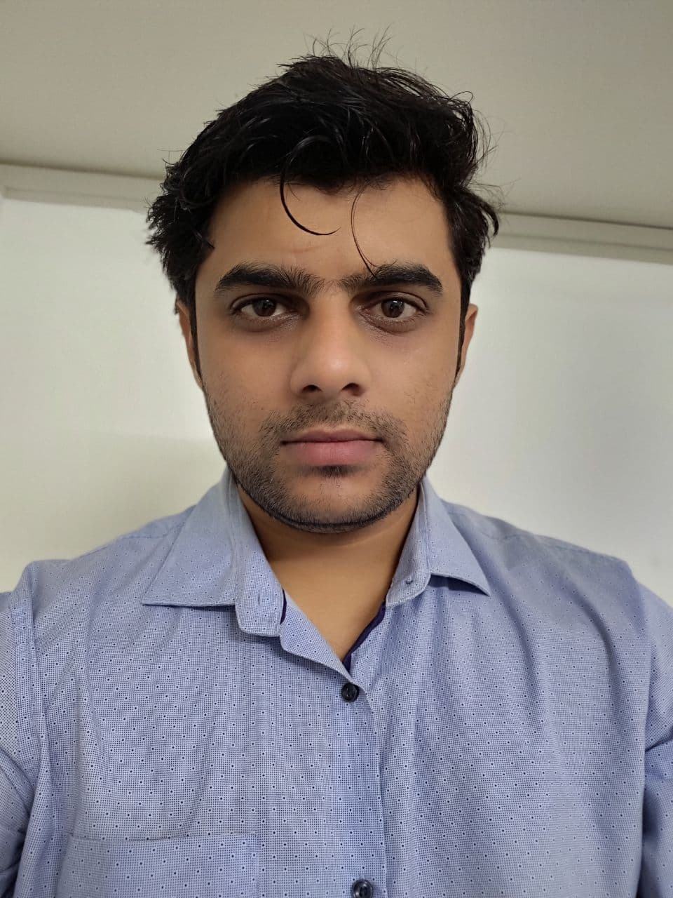
Director’s Message
We drive your data!
Niheel Sonar
Founder & MD
I hold experience of 14+ Years in IT Services Industry for Building Enterprise Applications & Government Projects. I have experience of working with Fintech, Lending, Manufacturing, Telecom, Services Industry Projects
The Open source softwares is growing tremendously faster and getting adopted by many fortune 500 companies too. The Small and Medium Scale Enterprises are in a strong position to get affordable and efficient technology solutions in comparison to another Licensed Applications.
If you don’t trust me then visit the link below
https://erpnext.com/enterprise

Slide 32
Our Services
On a Mission to help Enterprises get Efficient & Affordable Technology!
Enterprise Applications Consulting
ERP, CRM, HRM Implementations
& Maintenance
Custom Web & Mobile App Development
Enterprise Product Development
Web3
Technologies
Website: www.fileian.com
Email: team@fileian.com
Call: 9175 975 009 / 909 630 22 11

Slide 33
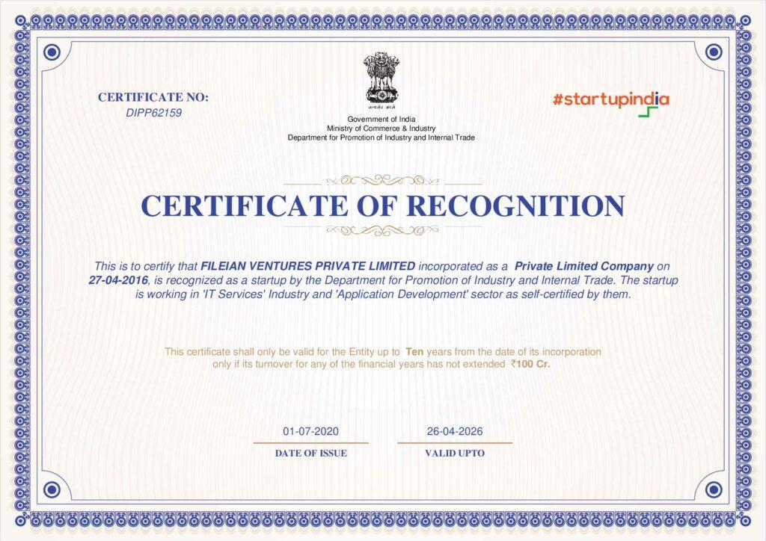
What are the recognitions?
Fileian is proud to showcase the recognitions for Quality Standard Certification displayed below
Website: www.fileian.com
Email: team@fileian.com
Call: 9175 975 009 / 909 630 22 11

Slide 34
How to engage?
Our experts will come up with all kinds of ideas and initiatives for delivering the best solutions of your expectations
Connect
Connect & share your
Requirement with Terms
Discovery Call
Requirement Generation
Agreement & NDA
Implement
Connect & share your
Requirement with Terms
Implement Modules
Data Migration & Testing
Client Training
Customize
Connect & share your
Requirement with Terms
Requirement Generation
Integrations, Migrations
Testing, Training, Launch
Maintain
Connect & share your
Requirement with Terms
Maintenance Contracting
Bugs fixing
Training & Support
* Terms & Conditions Applicable depending on Clients & Projects Requirements.
* For more details - Engage with our team or visit us at www.fileian.com
Website: www.fileian.com
Email: team@fileian.com
Call: 9175 975 009 / 909 630 22 11

Slide 35
Thank You !
For Pricing, Demo or any other information
Please email at team@fileian.com or call us at 9175 975 009 / 9096 302 211
Company Registrations CIN Number: U74999MH2016PTC280265
GST Number: 27AAFCD6767M1ZZ ISO 9001:2015 Number: IN13506A CMMI Level 3 Number: SPC19C3491
Fileian Ventures Private Limited (Indian)
Registered Office: 302, ARTIS, Govind Nagar, RD Circle, Nashik - 422005
Call: 9175 975 009 / 909 630 22 11
Website www.fileian.com | Email: email@fileian.com

